Slide 1

CSD 380: The Technology Value Stream
Colton Kohler
6/1/2025

Slide 2
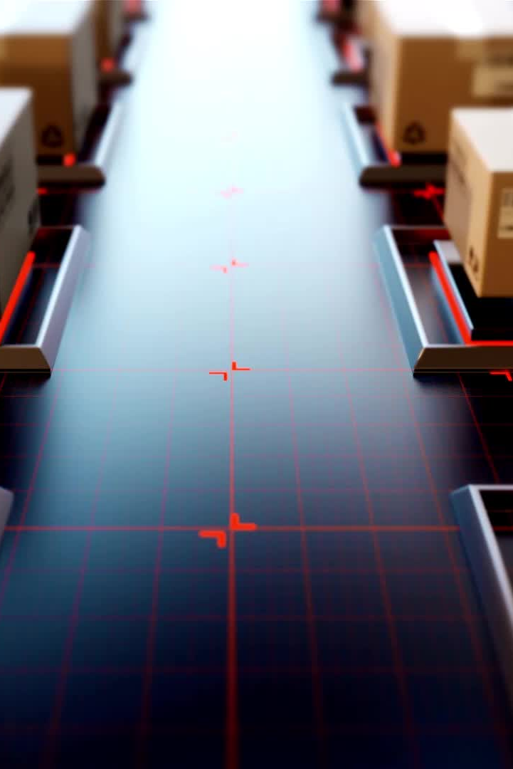
Introduction to the Technology Value Stream
A value stream is the set of activities needed to deliver a product or service.
In DevOps, the Technology Value Stream focuses on the flow of work from idea to deployment.
Key metrics include lead time, process time, and % complete and accurate (%C/A) (Kim et al., 2016).

Slide 3
Lead Time vs. Process Time
"Lead time starts when the request is made and ends when it is fulfilled" (Kim et al., 2016, p. 9).
"Process time starts only when we begin work"—it excludes waiting in queues (Kim et al., 2016, p. 9).
Improving lead time improves customer experience.

Slide 4
Visual - Lead Time vs. Process Time
Ticket Created
Work Started
Work Completed
Lead Time spans the full duration.
Process Time is only the active work portion.
Source: Kim et al., 2016, p. 9

Slide 5
Common Scenario – Lead Time of Months
In traditional environments: "deployment lead times require months" (Kim et al., 2016, p. 10).
Causes:
- Monolithic applications
- Long testing queues
- Manual approvals and testing
Results in firefighting and delays.

Slide 6
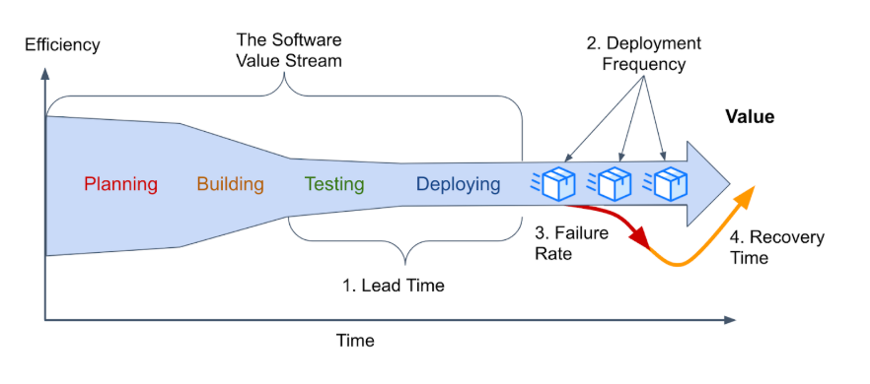
Common Scenario Graphic
Image Source: https://dora.dev/guides/value-stream-management/
In traditional organizations, every phase of the software value stream is slowed by delays and manual work.
“Heroics needed at each stage” means team members must constantly step in to resolve issues manually, coordinate across silos, and compensate for poor system design.
Delays in testing, approvals, and integration result in large batches of code with hidden issues.
Code often fails when merged, requiring time-consuming investigation and rework.
This leads to long lead times, increased failure rates, and slow recovery—hurting value delivery.

Slide 7
DevOps Ideal – Lead Time of Minutes
"Developers receive fast, constant feedback on their work" (Kim et al., 2016, p. 10).
Characteristics:
- Modular, loosely-coupled architecture
- Continuous integration and automated testing
- Fast and confident deployments

Slide 8
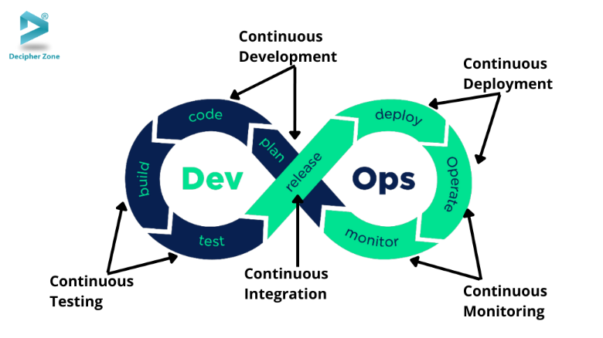
DevOps Ideal Graphic
This represents the full DevOps lifecycle emphasizing automation and continuous flow.
Continuous Integration, Deployment, Testing, and Monitoring reduce manual effort and lead time.
Supports fast recovery and higher system resilience.
Image Source: https://www.decipherzone.com/blog-detail/devops-testing

Slide 9
Key Metrics Summary
Lead Time: End-to-end customer experience
Process Time: Hands-on work time
% Complete & Accurate (%C/A): Quality of each stage’s output
"%C/A can be obtained by asking downstream customers what percentage of the time they receive work that is 'usable as is'" (Kim et al., 2016, p. 11).

Slide 10
References
Kim, G., Debois, P., Willis, J., Humble, J., & Allspaw, J. (2016). The DevOps handbook: How to create world-class agility, reliability, and security in technology organizations. IT Revolution Press.
DORA. (n.d.). Value stream management. Retrieved from https://dora.dev/guides/value-stream-management/
Decipher Zone. (n.d.). DevOps testing. Retrieved from https://www.decipherzone.com/blog-detail/devops-testing

